Slide 1

Demo open source applications with Intel RealSense capabilities Emotion tracker application
Arkhangelsk, 2016

Slide 2
Emotion tracker application
The main aim of this project is to develop a library and demo applications to track and write users emotions (sadness, smile, laugh, etc.) during watching movie. Test recognition of emotions with different conditions. Implement logic to “merge” files with emotions and provide average rating. Implement logic to gather eyes track and to build heat map for user’s attention. All of that should be done by using Intel RSSDK tools.
Arkhangelsk, 2016

Slide 3
Objectives
Emotions records format
Emotions tracking library
Implementation of logic to merge files with emotions and its averaging
Implementation of building heat map for user’s attention
Demos

Slide 4
Outcomes
It was created emotions processing ecosystem. It contains native library to make records of timed series of data connected with emotions estimated by RealSense camera. There is also C# wrapper to native library. It was implemented main merging primitives for emotions records and for processing of collected gaze data. There are two examples of using emotions tracking library and merging capabilities. It was implemented two utilities to make gaze heat map and to lay down gaze upon the video content. There is possibility to record RealSense camera streams and convert this record to common used video format using one of implemented utilities. Timed emotions records can be converted to one oaf the most user subtitles format. There is defined the way to do mathematical processing of emotions records. MATLAB codes has been provides and there is an utility to convert emotions records to csv format allowing to use collected data within a lot of applications, t.e., Excel, MATLAB, R, etc. It was found main use cases for created library.

Slide 5
Emotions records
TTML (https://www.w3.org/TR/ttml2/)
“The Timed Text Markup Language is a content type that represents timed text media for the purpose of interchange among authoring systems. Timed text is textual information that is intrinsically or extrinsically associated with timing information.”
Pros
Can be used as subtitles
Windows 10 Movies & TV
Is one of W3C's standards regulating timed text on the internet.
Cons
It is not wide used standard
Entail to produce large files
~50M per 5 minutes of tracking

Slide 6
Emotions records. Structure
<?xml version = "1.0" encoding = "UTF-8" ?>
<tt xmlns = "http://www.w3.org/ns/ttml"
xmlns:tts = "http://www.w3.org/ns/ttml#styling"
xmlns:ttm = "http://www.w3.org/ns/ttml#metadata" >
<head>
<metadata xmlns:ttm = "http://www.w3.org/ns/ttml#metadata">
<ttm:title>Timed Text TTML Example</ttm:title>
<ttm:copyright>The Authors(c) 2006</ttm:copyright>
</metadata>
</head>
<body>
<div>
<p begin="00:00:00.00" end="00:00:32.59">
<data type="text/plain; charset = us-ascii">
<metadata id="1"></metadata>
<![CDATA[
]]>
</data>
Neutral
</p>
</div>
</body>
</tt>
Timing information
Emotion
data
Emotion text

Slide 7
Emotions records. Data
<Face id="3">
<Landmark>
<Point>313.160400 255.806610</Point>
…………
<Point>367.559509 262.087280</Point>
</Landmark>
<Yaw>-0.641311</Yaw>
<Pitch>-0.965361</Pitch>
<Roll>6.649949</Roll>
<HeadX>-7.352272</HeadX>
<HeadY>-41.289234</HeadY>
<HeadZ>588.979553</HeadZ>
<Pulse>88.608482</Pulse>
<Gaze>78.696925 171.614583</Gaze>
<Brow_Raised_Left>0</Brow_Raised_Left>
<Brow_Raised_Right>0</Brow_Raised_Right>
<Brow_Lowered_Left>0</Brow_Lowered_Left>
<Brow_Lowered_Right>0</Brow_Lowered_Right>
<Smile>0</Smile>
<Kiss>0</Kiss>
<Mouth_Open>0</Mouth_Open>
…
…
<Closed_Eye_Left>0</Closed_Eye_Left>
<Closed_Eye_Right>0</Closed_Eye_Right>
<Eyes_Turn_Left>0</Eyes_Turn_Left>
<Eyes_Turn_Right>57</Eyes_Turn_Right>
<Eyes_Up>0</Eyes_Up>
<Eyes_Down>100</Eyes_Down>
<Tongue_Out>0</Tongue_Out>
<Puff_Right_Cheek>100</Puff_Right_Cheek>
<Puff_Left_Cheek>0</Puff_Left_Cheek>
</Face>
<Person id="0">
<Neutral>0</Neutral>
<Happiness>36</Happiness>
<Sadness>858993460</Sadness>
<Surprised>858993460</Surprised>
<Disgusted>858993460</Disgusted>
<Contemptful>858993460</Contemptful>
<Fearful>858993460</Fearful>
<Angry>858993460</Angry>
</Person>

Slide 8
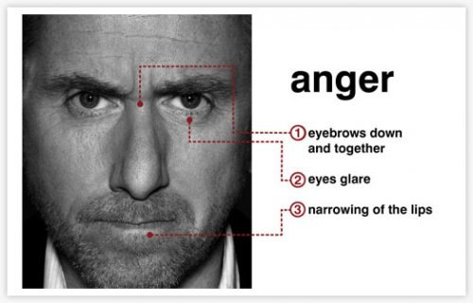
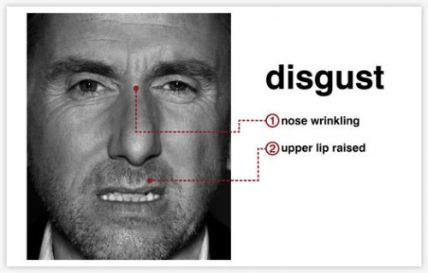
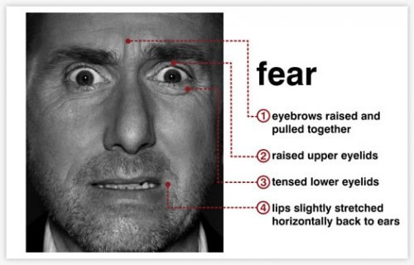
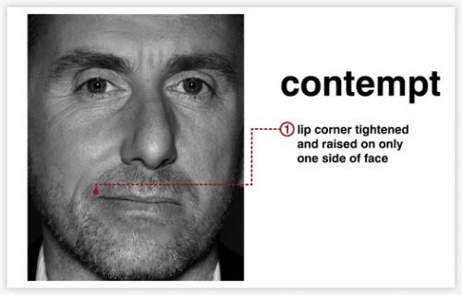
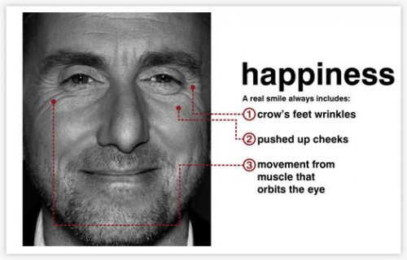
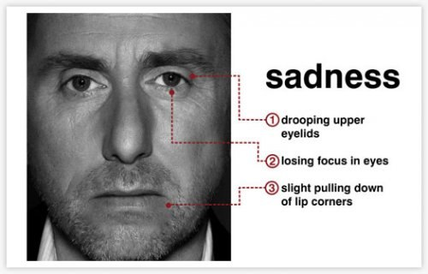
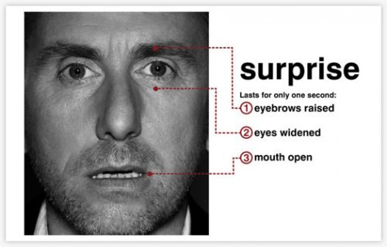
Emotions detection

Slide 9
Emotions detection
Can’t be percept
by RealSense API

Slide 10
Emotions tracking library
Native library
C# wrapper

Slide 11
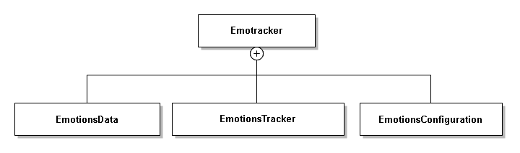
C# Class Diagram

Slide 12
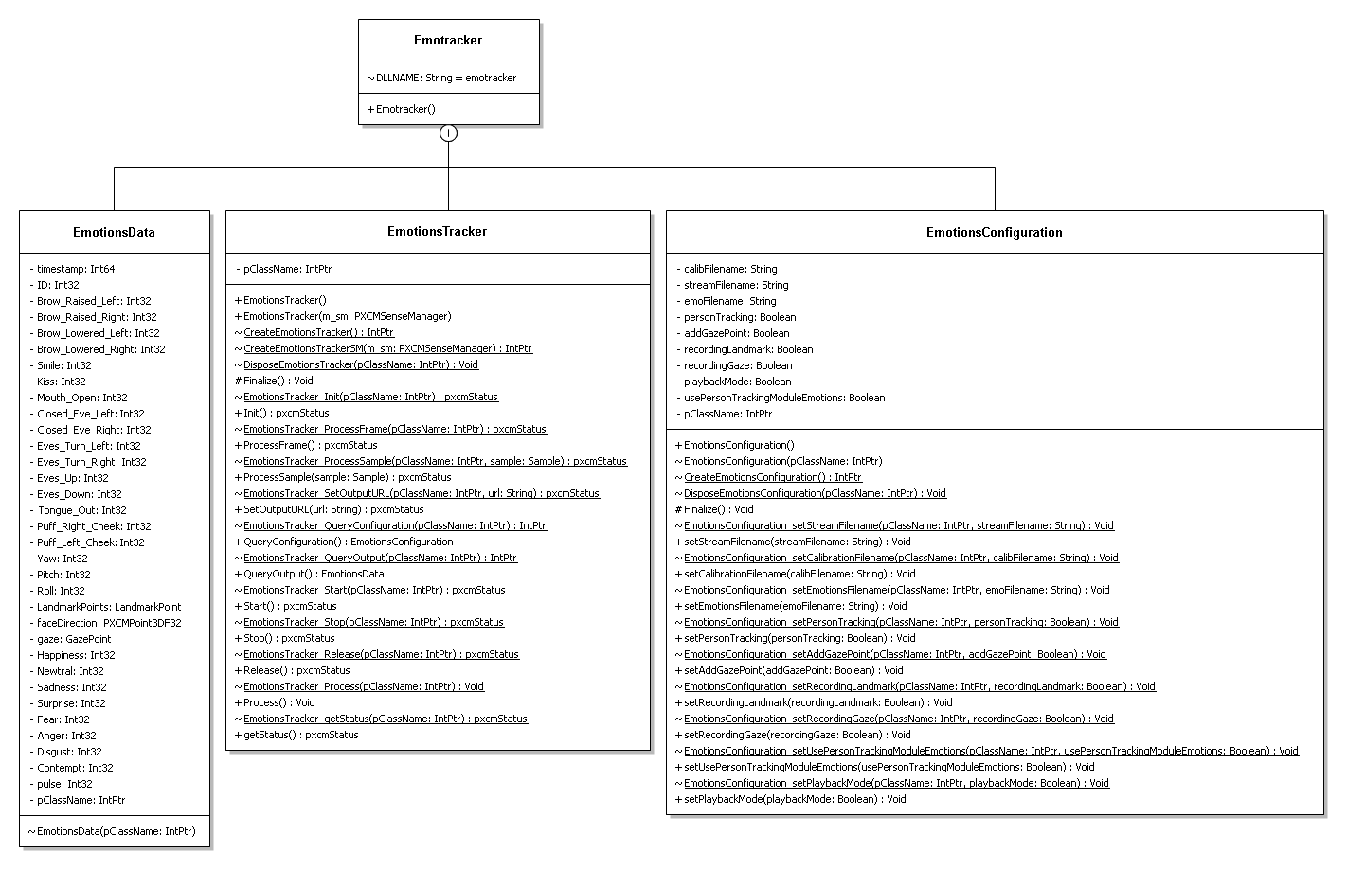
C# Class Diagram

Slide 13
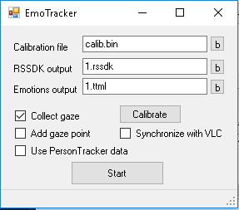
Sample to use library
EmoTracker
Provide library information about gaze calibration file location
Specifies output file names
Provides calibration utility
Provide user to select recording options
Provides ability to synchronize recording and playing media with VLC media player
Minimized to tray

Slide 14
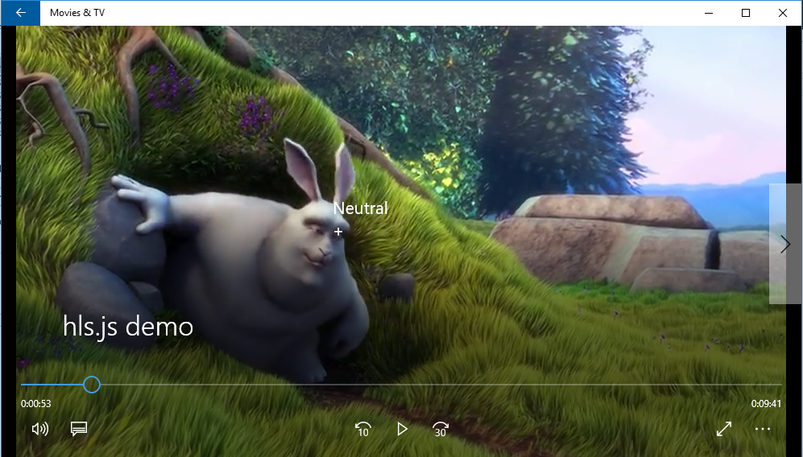
Add gaze point
Write gaze mark in subtitle
Can be used with Windows 10 Movies&TV player
Play with a bit modified HTML5 player

Slide 15
Use PersonTracker data
Use RealSense Person Tracking module to determine expressions
Pros.
Realsense SDK ability to accept emotions may be improved in future
Cons.
Only neutral and happy emotions are accepted
Is not more accurate than simple “smile>20” in emotracker library

Slide 16
Synchronize with VLC
Provides ability to simultaneously start emotions recording and movie showing using VLC media player

Slide 17
Merging and averaging
Main primitives
Merge
Average
Smooth

Slide 18
Merge
Merging two time lines
Merging emotions data
|------||--------------| |----------||---------||--|
|--------------------------||---------||------------||-----|
|======||==============||==||===||====||====||======||=||==|
|<Face id="0">| |<Face id="0">| |<Face id="1_0">|
|... | + |... | = |</Face> |
|</Face> | |</Face> | |<Face id="2_0">|
|<Face> |

Slide 19
Averaging
Find average value for all numeric data
smile, kiss, gaze, …
Drop Landmark
Find most frequently occurring emotion (text)

Slide 20
Smoothing
Common frame rate of camera is 50 fps
Library collect 50 emotions data samples per second
To be more human percept one should provide emotions data for longer time interval
Make averaging for some time interval
Same rules as for average

Slide 21
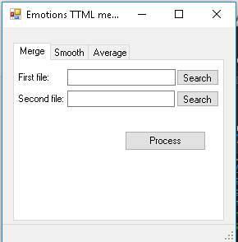
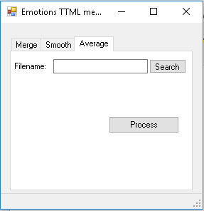
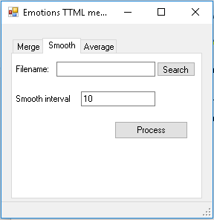
Merging work flow
Merge -> Average -> Smooth
EmoMerge

Slide 22
Gaze tracking
Calibration
Seems to be very important (various desktop size, various position of camera between examinations)
Saccades
It leads to necessity to do more investigations to find real points of attention

Slide 23
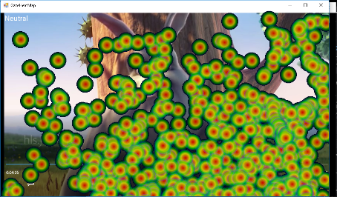
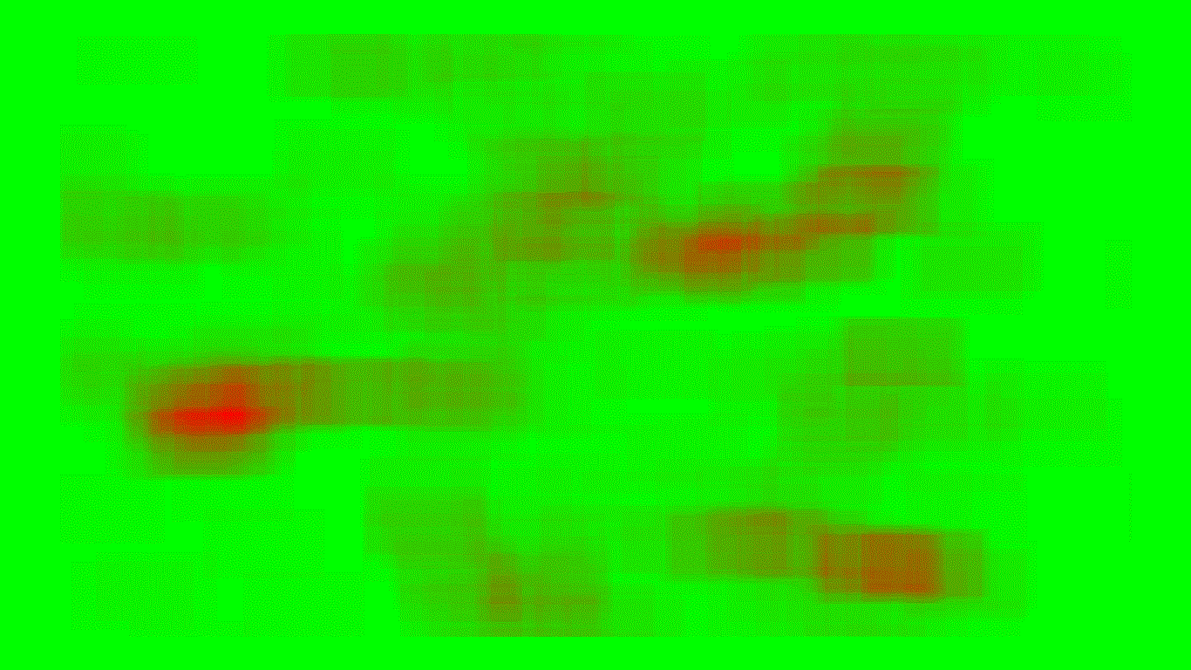
Heat map
Two varieties
Set of gaze points
Blurring the 2D histogram of gaze points occurrences by convolution with arithmetic mean filter response

Slide 24
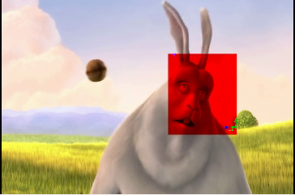
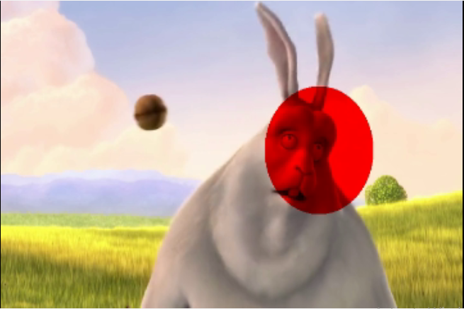
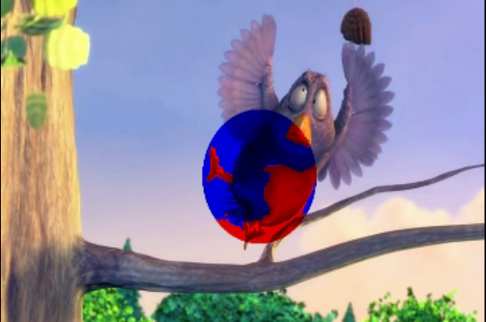
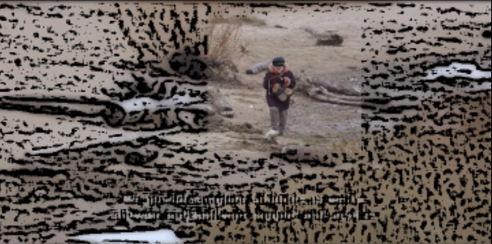
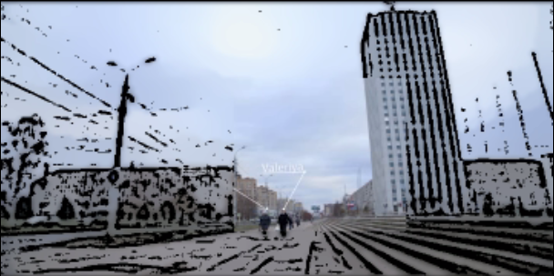
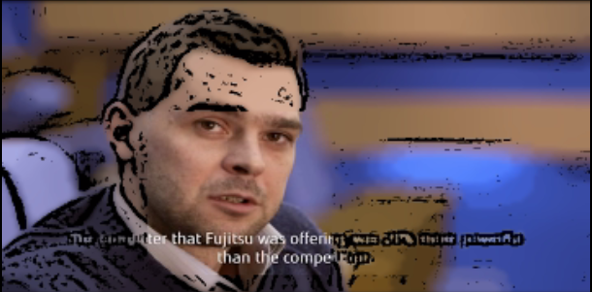
GazePainter
Curently two filters / two gaze shapes for first filter
MaxRGB
Cartoon

Slide 25
GazePainter. Usage
-------------------------------------------------------------------------------
This program add collected by emotions tracking library gaze points
to video file and encode it with installed codecs.
You can specify frame rate, size and encoding of output video.
Usage:
GazePainter inputTTML inputvideoName outputvideoName [-f fps] [-S width height]
[-Y] [-mode mode] [-filter filter] [-sm width height]
-f frame rate in fps
-S output video size
-Y provide choosing of output format
-mode mode = {square|round}
-sm width and height of gaze mark
-filter filter={maxrgb|gray|cartoon}
-av exponential weighted gaze point average
-h help
-------------------------------------------------------------------------------

Slide 26
GazePainter. Usage
Notes
-f do not resample video stream, it used only for adjusting output frame rate to RealSense camera frame rate
Emotions tracking frame rate ~50 fps
round mode currently not implemented for cartoon filter
-Y option allows to choose encoding installed on the system and recognized by OpenCV library

Slide 27
Processing with MATLAB
function [b,e,v]=getEmoElement(fname,el)
function [b,e,v]=getEmoElementStr(fname,el)
Slow (it takes about hour to process 50M file = 5minutes of records )
One can use ttml2csv utility to convert data in csv format
Load data in MATLAB to do its examination
One can also use it f.ex. with Excel

Slide 28
Additional utilities
rssdk2video
ttml2srt

